Slide 1

MongoDB & Node.js
Ranken Technical College

Slide 2
Objectives

Slide 3
Setup
npm mongodb
npm config
connecting

Slide 4
npm install mongodb
The official MongoDB driver for Node.
Sources
https://www.npmjs.com/package/mongodb
https://docs.mongodb.com/drivers/node/

Slide 5
npm install config
Organize your configurations in a hierarchical structure to facilitate easy app deployment.
Define a set of default parameters and extend them for different deployment environments (development, qa, staging, production, etc.)
Configurations are stored in configuration files within your application and can be overriden by environment variables.
Sources
https://www.npmjs.com/package/config

Slide 6
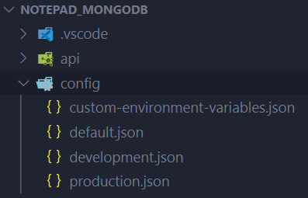
config folder structure
Create a folder named config in the root folder of your application and add the following files to it:
custom-environment-variables.json
default.json
development.json
production.json

Slide 7
default.json
This file is used to specify default values for your configuration parameters.
Add the code below to the file.
{
"debug": "app:*",
"http": { "hostname": "localhost","port": "3000" },
"db": { "name": "my_database_name", "uri": "mongodb://localhost" }
}

Slide 8
custom-environment-variables.json
This file is used to specify which environment variables will override your configuration parameters.
Add the code below to the file.
{
"debug": "DEBUG",
"http": { "hostname": "HOSTNAME","port": "PORT" },
"db": { "name": "DB_NAME", "uri": "DB_URI" }
}

Slide 9
development.json
This file is used to specify configuration parameters for your development environment.
Add the code below to the file.
{}

Slide 10
production.json
This file is used to specify configuration parameters for your production environment.
Add the code below to the file.
{}

Slide 11
Using config to retrieve the connection string
const config = require('config');
const DB_NAME = config.get('db.name');
const DB_URI = config.get('db.uri');

Slide 12
Connecting to the database
let databaseConnection = null;
async function connect() {
if (!databaseConnection) {
debug('connecting to database...');
const client = await MongoClient.connect(DB_URI, {
useNewUrlParser: true,
useUnifiedTopology: true,
poolSize: 10,
});
databaseConnection = client.db(DB_NAME);
debug('connected.');
}
return databaseConnection;
}

Slide 13
CRUD
Reading & Writing data with MongoDB

Slide 14
CRUD
Operation | SQL | MongoDB | HTTP
Create | insert | insert | POST
Read/Retrieve | select | find | GET
Update/Modify | update | update | PUT
Delete/Destroy | delete | remove | DELETE
Sources
https://en.wikipedia.org/wiki/Create,_read,_update_and_delete

Slide 15
Example: Getting all documents in a collection

Slide 16
Example: Getting some documents from a collection

Slide 17
Example: Getting one document from a collection

Slide 18
Example: Inserting Documents

Slide 19
Example: Updating Documents

Slide 20
Example: Upsert

Slide 21
Example: Deleting Documents

Slide 22
Conclusion
What did we learn today?

Slide 23
Objectives

